Slide 1

Project Blink
Proof of Speed - 1.2 Block Size per second

Slide 2
How Blockchains Speed depends on Block Size per sec ?
Each Transaction has a fixed / dynamic size in range of 100 bytes to 1KB
Account Model Blockchains - T < 200 Bytes
UTXO Model - T > 200 Bytes
Bitcoin Block Size 10 mins = 1 MB ; 1 sec = 1666 bytes = 0.001 MB at average 300 byte a transaction it can do 5.5 transaction per second
More Block Size = More Transactions
Less Block Time = Faster Confirmation
Scalability is directly proportional to a blockchain having larger blocks with shorter block time

Slide 3
Why a fixed Block Size ?
For efficient propagation of blocks
More Decentralization
Personal Computers can Join
Lesser Computation on Validation
Lesser Requirement
Predictable Increase in Ledger size

Slide 4
The Idea of Mutable Block Size
Let’s assume that all of the bitcoin mining nodes are running on an internet
bandwidth of 1mbps i.e., 125 KiloBytes per second, which is very basic in the
current computing era. For a span of 10 mins every node can able to download
about 75MB of data on average, 75 times more than the bitcoin’s condition of
1MB. If a block per 10 min is 75MB in size, the protocol can do about 300+
transactions per second. This is the basic concept of Blinkchain’s Block Size
determination algorithm.

Slide 5
In Blinkchain, the block size is determined by the nodes, not the developers. The network determines the block size at each epoch and requires the block producers (miners) to validate and transmit blocks over a span of time (Blink-time).
Other Blockchains | Blinkchain
Fixed Block Size | Dynamic Block Size
Fixed by Developers | Fixed by Nodes
Changes only on hard-forks | Changes as per conditions and requirements every n blocks

Slide 6
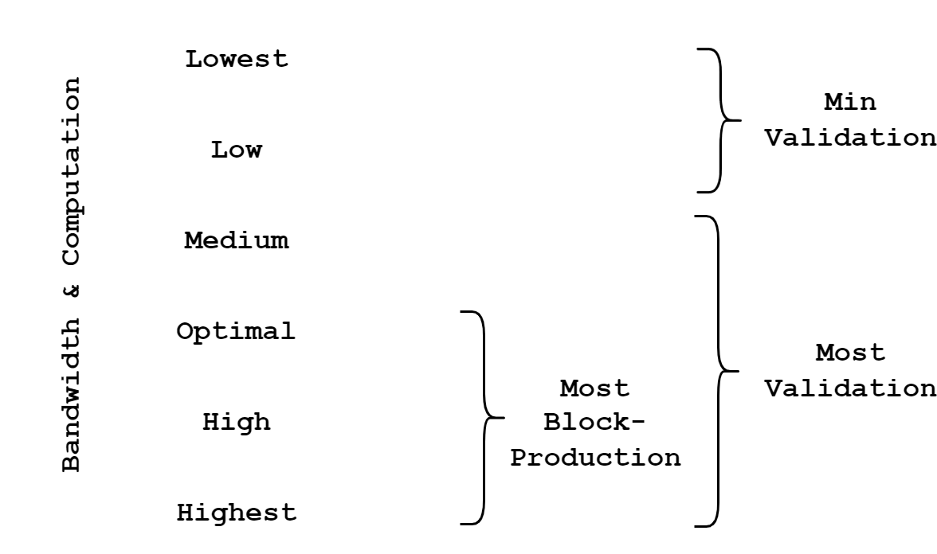
Types of Nodes

Slide 7
Nodes are Speed
In a cluster of nodes - Higher, Optimal and Lower Nodes will be there. Downloading and validation of blocks are based on propagation of blocks
To keep high throughput - only nodes higher than optimal nodes should mine blocks
Mining Blocks - Need higher nodes ; Validation - Optimal Nodes
All nodes are required to submit a bandwidth proof in which the requirement is found, the central value

Slide 8

Median Bandwidth
Median of all Nodes bandwidth is taken and the requirement is set
This way only the optimal and higher nodes can participate in the block production
Block Production is Mining blocks, a producer is a miner
Median Bandwidth = Threshold Bandwidth = Minimum Bandwidth Requirement

Slide 9
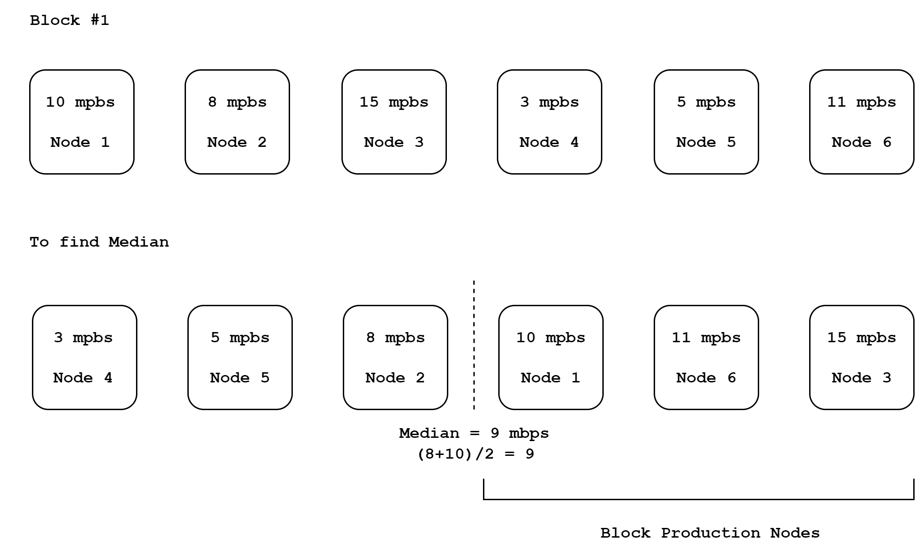

Slide 10
Blocks Max size per second
Median Bandwidth is represented in Bits/sec
Median Bandwidth (M) is the requirement to Join a Production cluster
Now Block Max size is found
From median bandwidth a latency is subtracted to find the Block Max Size / sec. Latency is found by submitting a latency proof by nodes to keep the propagation smooth.
These are found per epoch, as epoch represents a time-period.

Slide 11
Next : 1.3 Blink, Legates, IHR

